Slide 1



Spotify Playlist
Module 5 by: Payam Abbasi
Date: 12/21/20
Program: ds-pt-030220

Slide 2

What is Spotify?
Spotify is a digital music, podcast, and video streaming service that gives you access to
millions of songs and other content from artists all over the world.

Slide 3

What Are The Benefits of Having Spotify?
Spotify works on various of platforms
Spotify is simple to use. It allows users to listen to any song whenever they want, for as many times as they want
Spotify offers free subscription
Spotify has large music catalog

Slide 4

Objective
To find out what make a song popular on Spotify.

Slide 5
Methodology
Data Processing
Data Modeling
Model Evaluation

Slide 6
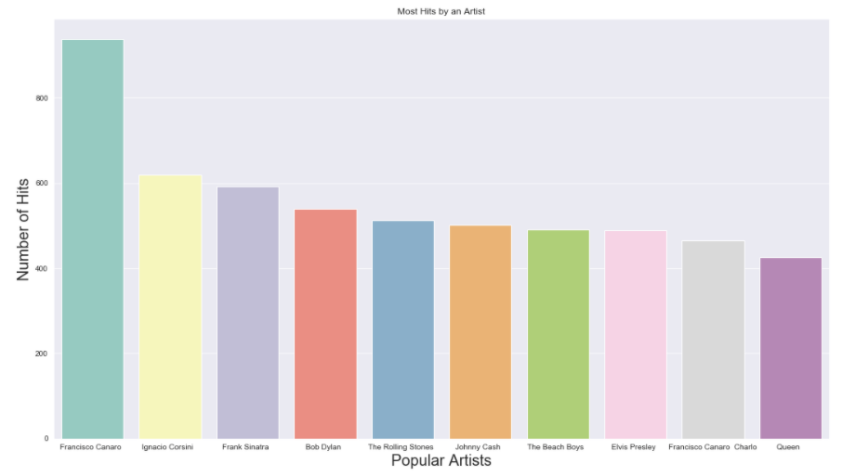
Most Hits by an Artist

Slide 7
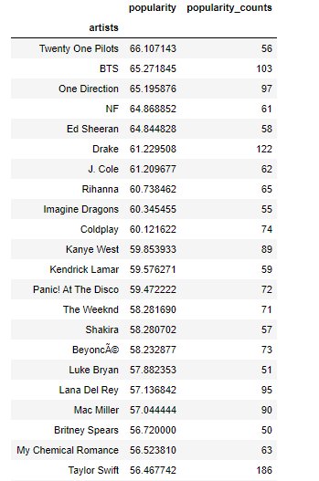
Most Popular Artist

Slide 8
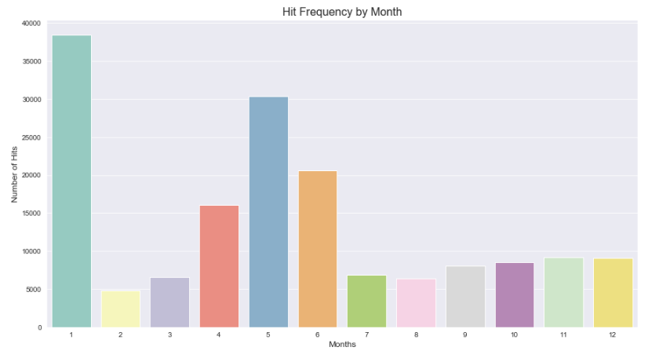
Hit Frequency by Month

Slide 9
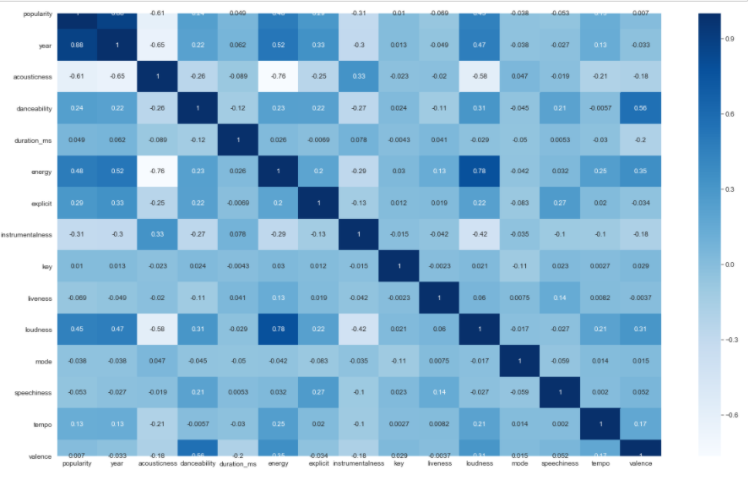
Correlation

Slide 10
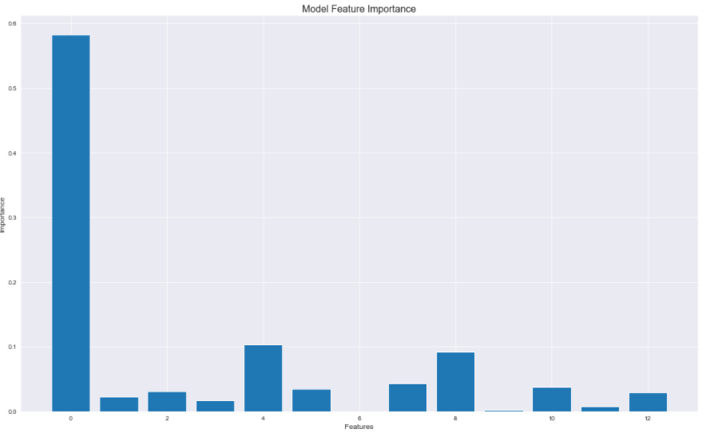
Model Feature Importance

Slide 11

Future Work
Look into genre
Look into an artist/labels budget
Look into marketing

Slide 12


